Slide 1

Intro to DevOps
Agenda
SDLC
Scrum Methodology
Need for DevOps
DevOps Arch
DevOps Toolset
DevOps Learning

Slide 2
SDLC – Software Development Life Cycle
Definition: A structured process for designing, developing, and maintaining software.
Goals:
Deliver high-quality software
Meet user requirements
Manage costs and timelines effectively
Key Stages:
Planning - Establishing project goals and a roadmap.
Requirements Analysis - Gathering requirements and defining project scope
Design - Creating system architecture and design specifications.
Development - Writing and deploying the code.
Testing - Verifying that the software meets requirements and is bug-free
Deployment – where fully developed and tested software is released for intended users
Maintenance – ongoing process of supporting and modifying software after its deployment

Slide 3
Advantages of SDLC
Improved Project Management: Provides a roadmap and framework for the development process.
Reduced Risks: Early identification and mitigation of potential issues.
Enhanced Communication: Clearer understanding of roles and responsibilities.
Increased Efficiency: Streamlined workflows and better resource allocation.
Better Quality Software: Ensures thorough testing and reduces defects.

Slide 4
Project Methodologies
Waterfall Model
Linear Approach: Sequential phases with no overlap.
Strengths: Simple, easy to understand, well-defined stages.
Weaknesses: Rigid, inflexible, difficult to accommodate changes.
Best Suited For: Small projects with well-defined requirements.
Agile Model
Iterative and Incremental: Development in short cycles (sprints).
Focus on Flexibility and Collaboration: Adapts to changing requirements.
Examples: Scrum, Kanban, Extreme Programming (XP).
Strengths: Adaptable, customer-centric, promotes collaboration.
Weaknesses: Can be challenging to manage, requires highly skilled teams.
Spiral Model
combine elements of both iterative development and waterfall model
Focus : will be on risk analysis and mitigation at each spiral.
Suitability : Large and complex projects
Strengths: Risk-driven (for uncertain requirements), High flexibility for changes and iterations
Weaknesses: Complex to manage, requires expertize in risk mgmt. and continuous planning
V - Model
Verification and Validation: Emphasizes testing throughout the development cycle
Focus : Each phase has corresponding testing phase
Suitability : Large and complex projects
Strengths: Strong emphasis on quality assurance
Weaknesses: Less flexible, may not be suitable for complex projects
Choosing Right Model
Project size and complexity
Team skills and experience
Project requirements
Organizational culture
Risk tolerance
Prototype Model
Big Bang Model

Slide 5
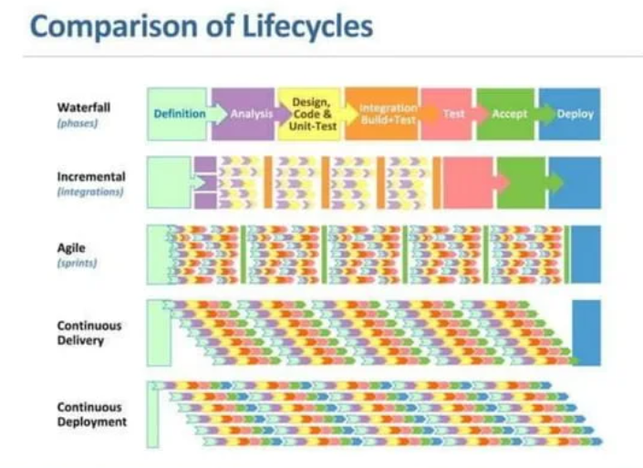

Slide 6
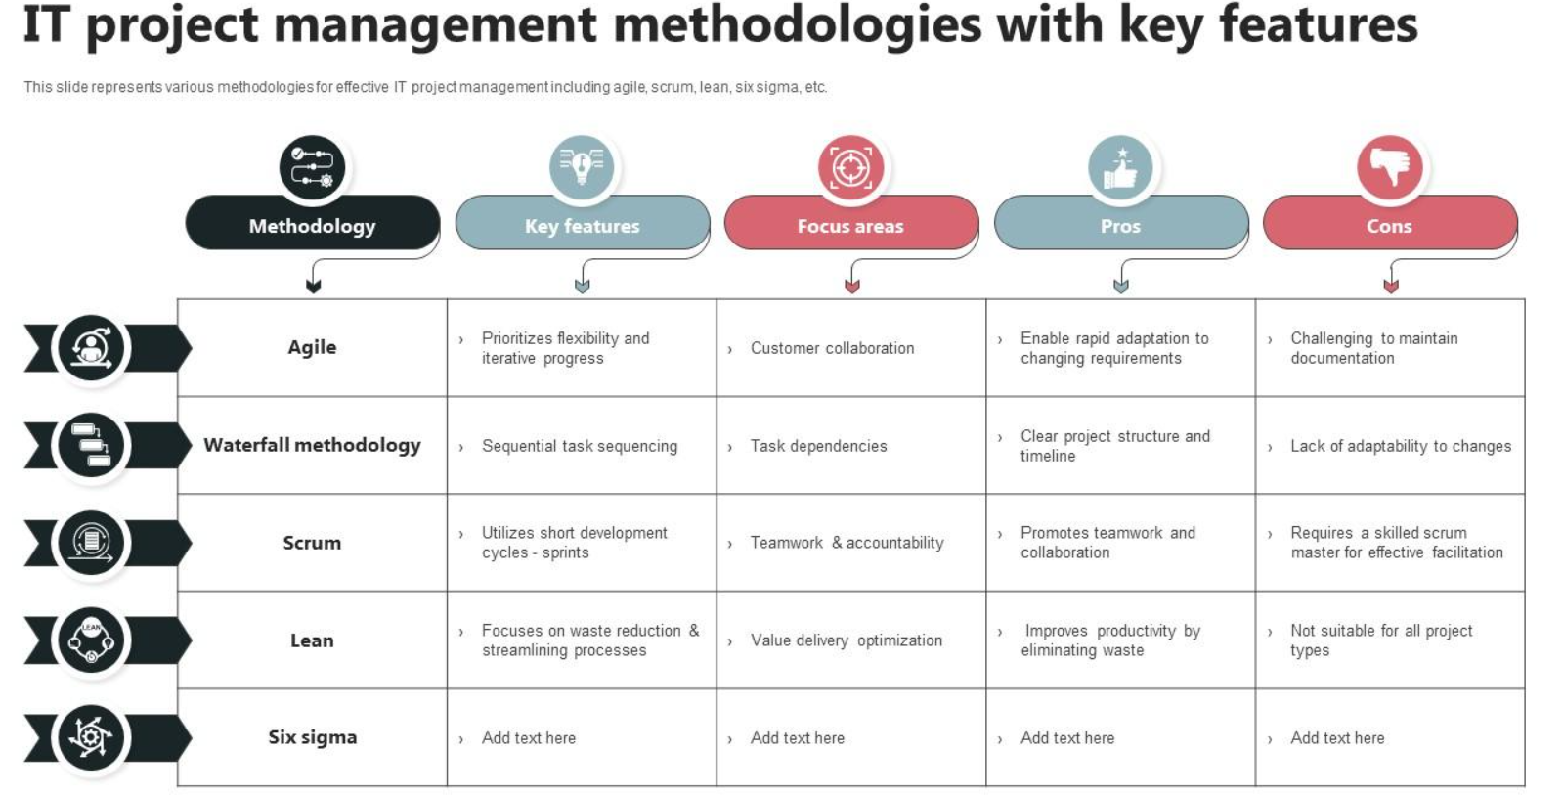
DMAIC

Slide 7
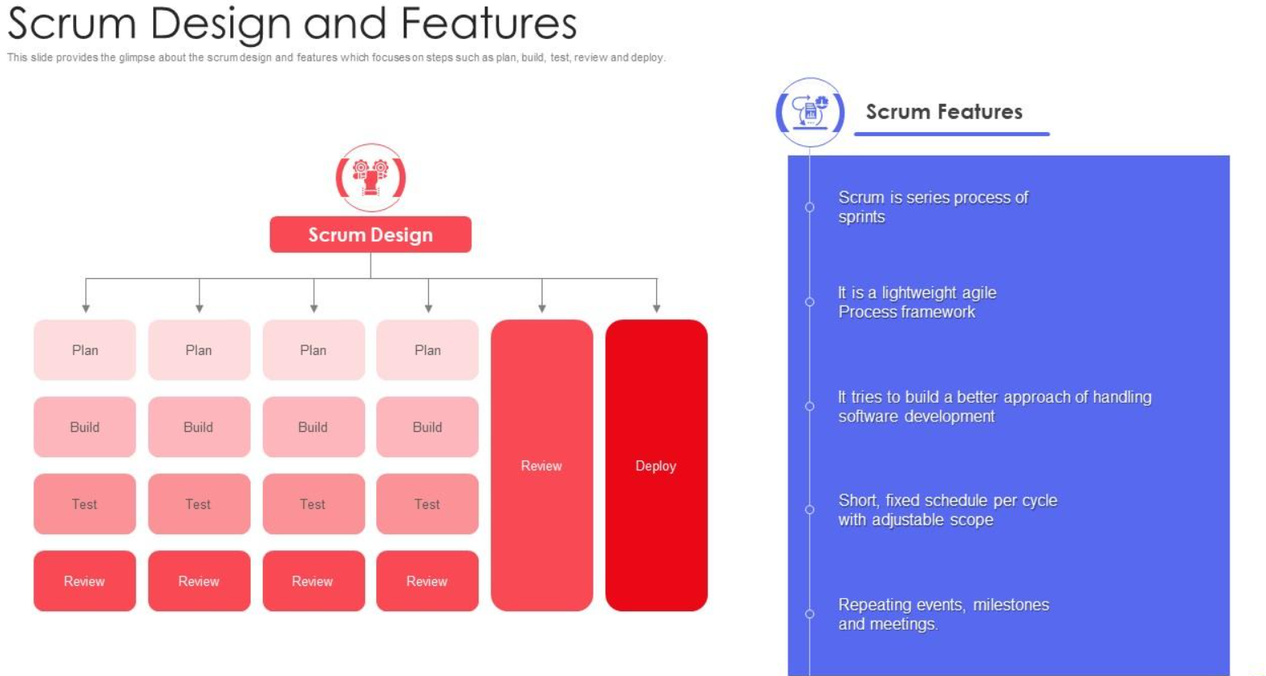

Slide 8
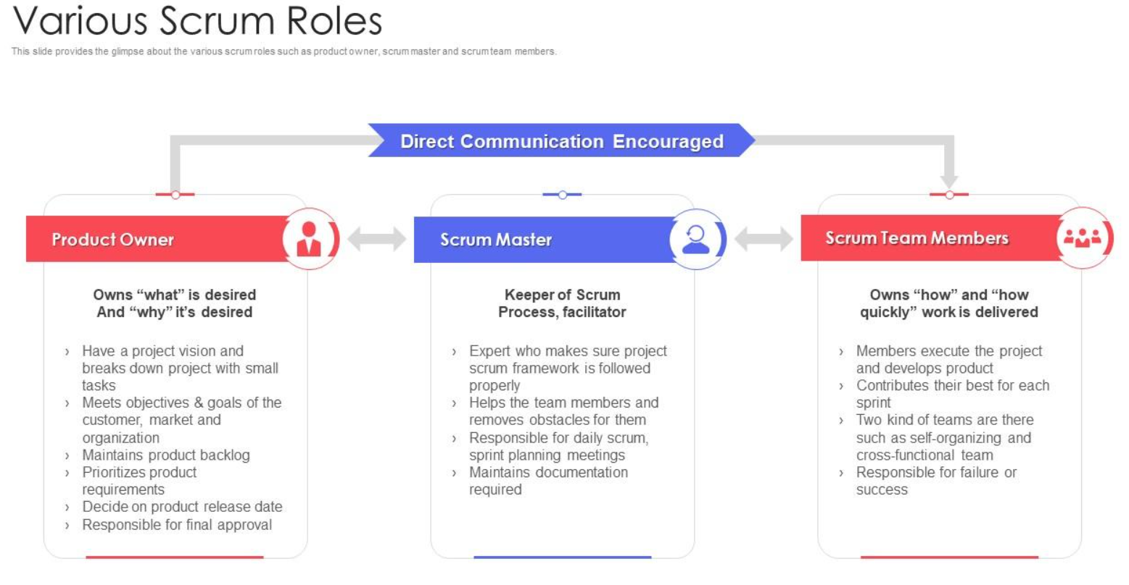

Slide 9
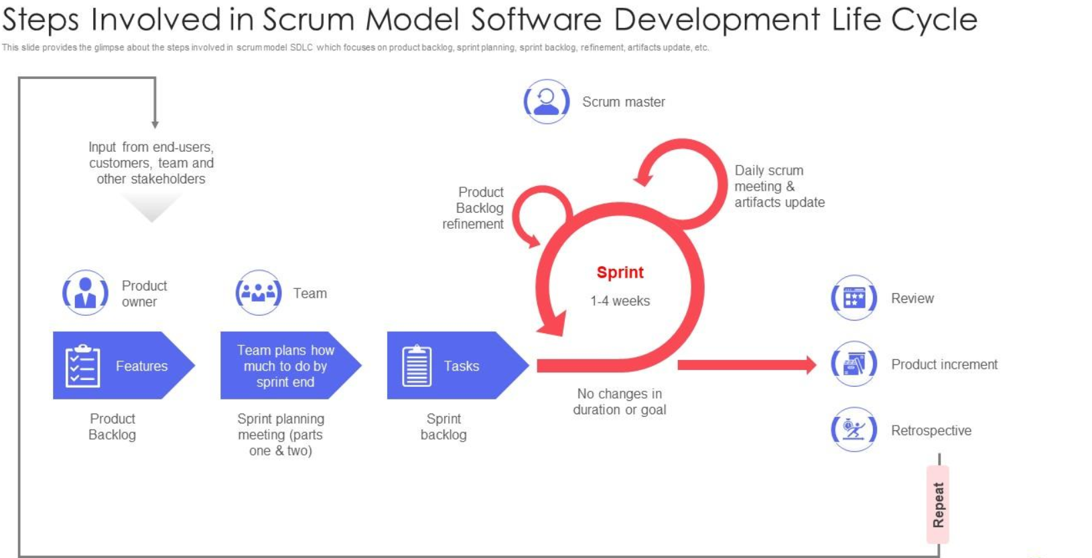

Slide 10
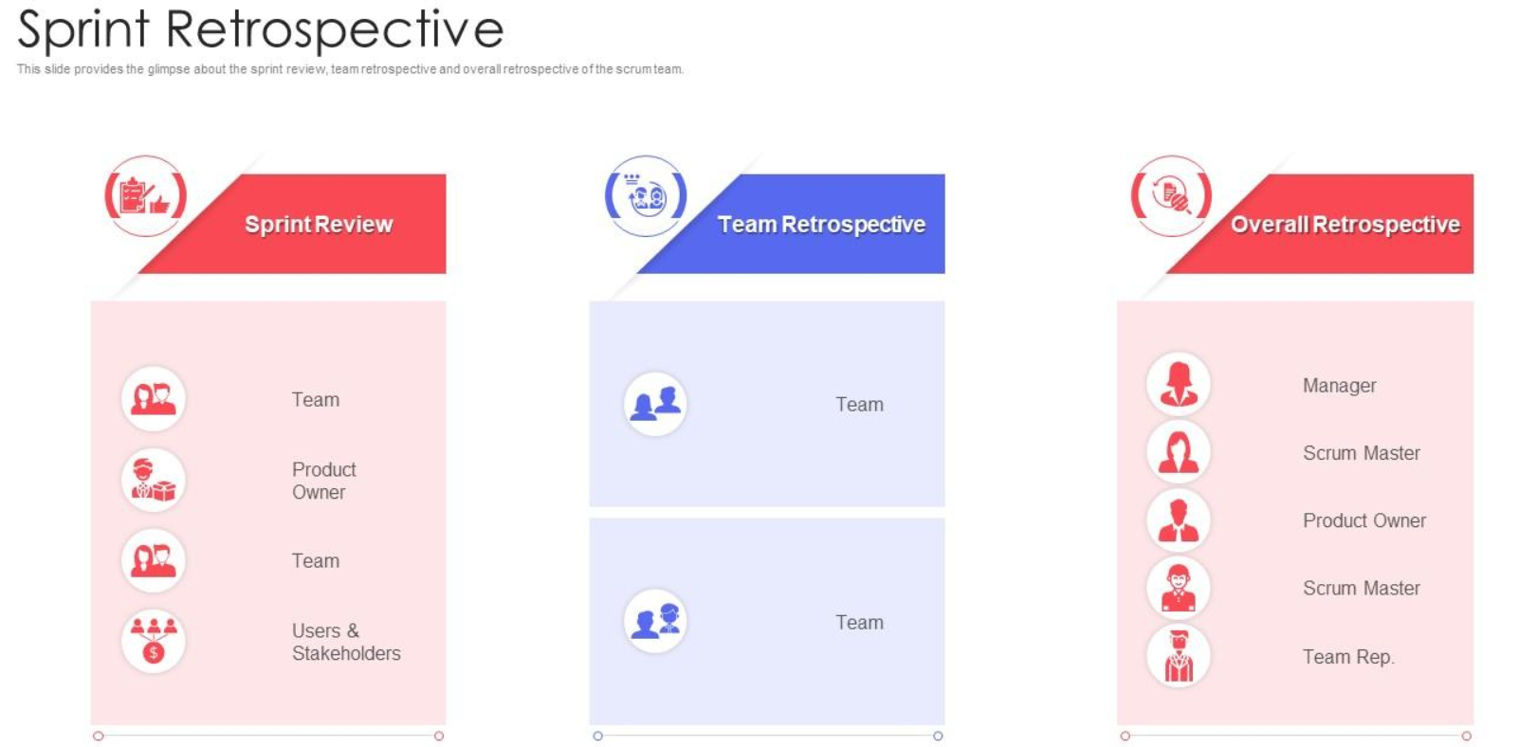

Slide 11
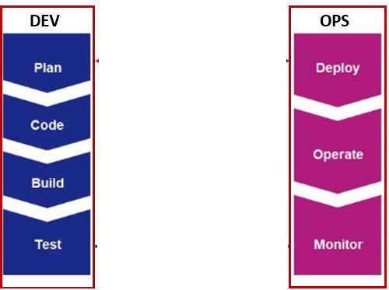
Development & Operations - Issues
Different Priorities and responsibilities
Deployment Frequency and Stability
Change management and Control
Communication and Collaboration
Blame Culture

Slide 12
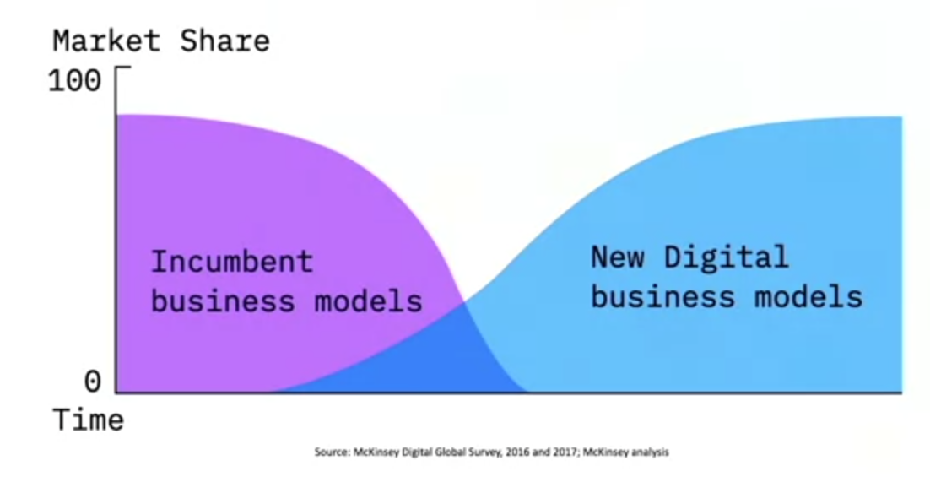
Business case for DevOps
How disruption facing companies today amplifies need for DevOps
Since 2000, 52% of fortune 500 companies disappeared
If not disrupted – When are going to get disrupted
Disrupters always have a different business model
**Digitization + Business Model
Banking
Uber – GPS, Electronic Payments, Smartphone/Internet
Netflix Success / Blockbuster failure
Garmin
#Technology is enabler of innovation and its not the driver of innovation
You must have great business model idea and a great model and then leverage technology

Slide 13
DevOps
DevOps is not a tool / Job title , it is a shared mind set
Fastest growing skills
#1 – issues around organizational learning and culture
DevOps is the practice of development and operations engineers working together through
the entire software development lifecycle, following Lean and Agile principles that allow them to deliver software in a rapid and continuous manner.
If you want to do it fast …and you want to do it continuously, then you need to adopt a shared mindset that is at the heart of the DevOps culture.
How to change Culture – How to think, how to work, how to organize and how to measure
Team culture makes a large difference to a team’s ability to deliver software and meet or exceed their organizational goals.
In order to change your culture, you’ll need to organize your teams differently because how you
organize directly impacts the architecture and design of the products that you produce.

Slide 14
DevOps Adoption
A different mindset
Unlearn your current culture and embrace for change
Fail Fast and Rollback quickly – Maximum velocity and minimum risk
Test in-market instead of Analyzing – Gain quick and valuable insights
Application designed to allow individual components to be released – ex – Spotify (Recommendation engine)
TTD – Trust , Transparency and Discipline
Teams working for a common goal

Slide 15
Need for DevOps
Shorter Development Cycle, Faster Innovation
Reduction of implementation Failure
Improved customer experience
Improved communication and Cooperation
Increased Competencies
2016 DevOps Enterprise Summit
TicketMaster – 98 % reduction in MTTR
Nordstorm – 20% shorter lead time
Target – Full stack deploy from 3 months to minutes
USAA – Release from 28 days to 7 days
ING – 500 application teams doing DevOps
CSG – 200 incidents per release to 18

Slide 16
Agility is Key for DevOps
DevOps
Microservices
Cultural change
Automated pipeline
Infrastructure as a code
Immutable infrastructure
Loose Coupling / Binding
RESTful APIs
Designed to resist failures
Test by breaking/fail fast
Containers
Agility
Portability
Developer centric
Ecosystem enabler
Fast startup

Slide 17
Definition of DevOps
“The term (development and Operations) is an extension of agile development environments that aims to enhance the process of Software delivery as a whole. - Patric Debois
DevOps is a set of practices that combines software development (Dev) and IT operations (Ops). It aims to shorten the systems development life cycle and provide continuous delivery with high software ¹ quality
A Cross-disciplinary community of practice dedicated to the study of building, evolving and operating rapidly-changing resilient systems at scale - Jez Humble
An IT mindset encouraging communication, collaboration, integration and automation among software developers and IT operations to improve the speed and quality of delivering software – VersionOne
A set of practices and cultural changes – supported by the right tools – that creates an automated software delivery pipeline, enabling organizations to win, serve and retain customers - Forrester
A professional movement advocating a collaborative working relationship between Development & IT operations, resulting in the fast flow of planned work, while simultaneously increasing the reliability, stability, resilience & security of the production environment. – Gene Kim

Slide 18
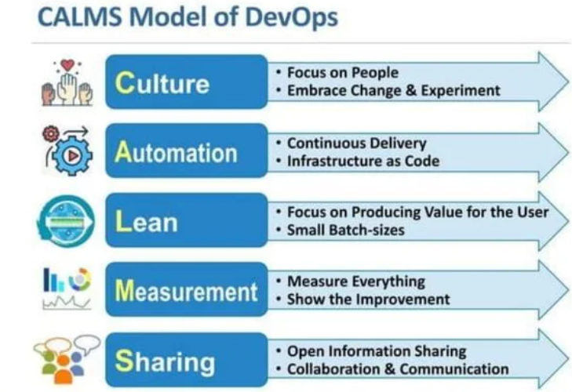
DevOps – What it is / What it is not
DevOps is
Working in Silos doesn’t work
Development and operations engineers working together
Following lean and agile principles
Delivering software in a rapid and continuous manner
DevOps is not
Simply combining development and operations
Not a separate team
Not a tool
Not one size fits all
Not just automation

Slide 19
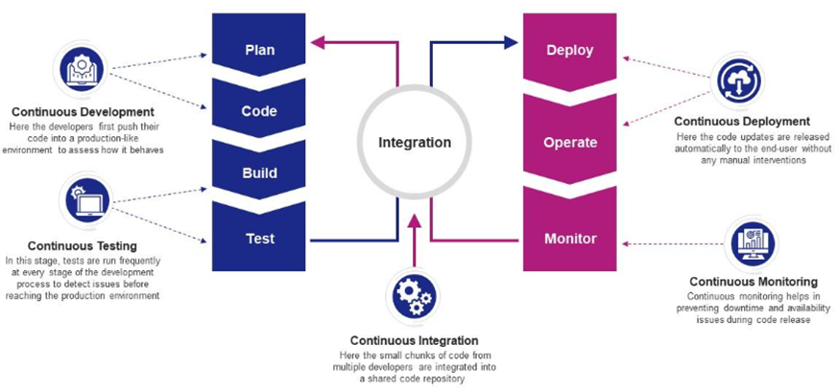
Defining Phases of DevOps Pipeline (1/2)
DEV
OPS

Slide 20

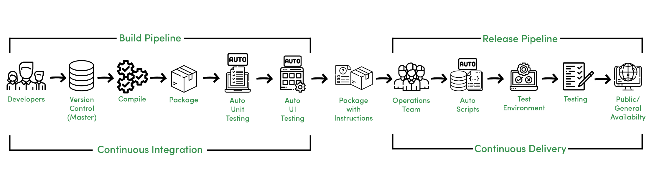
Defining Phases of DevOps Pipeline (2/2)
Continuous Development
Continuous Integration
Continuous Deployment
Continuous Delivery
Production Feedback and Continuous Monitoring

Slide 21
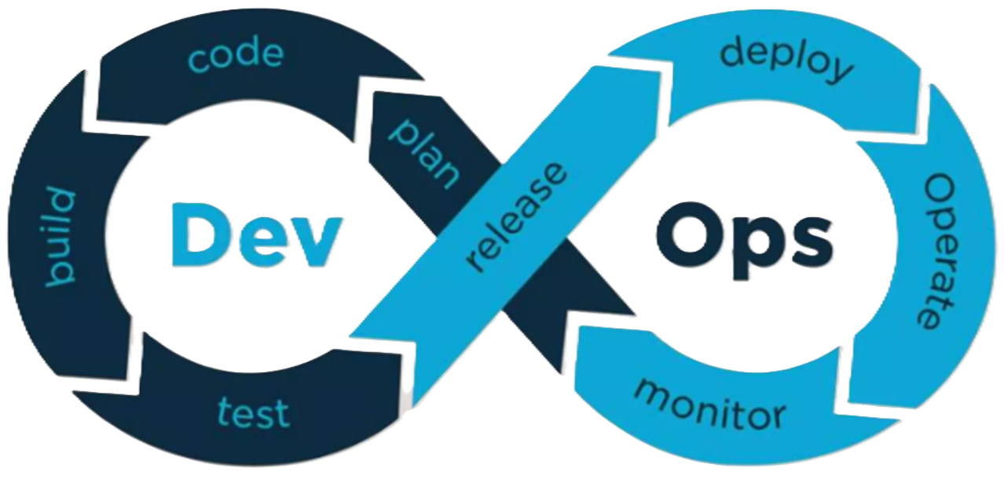
DevOps Infographic
DevOps is software development methodology which improves the collaboration between developers and operations team using various automation tools. These automation tools are implemented using various stages which are a part of the DevOps Life Cycle.

Slide 22
Continuous Development
Continuous Development (CD) is a software development approach that focuses on the rapid and incremental development of software. It emphasizes frequent, small changes to the codebase, rather than large, infrequent releases.
Key Principles of Continuous Development
Frequent commits
Small Changes
Automation
Collaboration
Feedback loops
Benefits of Continuous Development
Faster Time to market
Improved quality
Reduce Risk
Increase productivity
Enhanced Collaboration

Slide 23
Continuous Integration
Continuous Integration (CI) in DevOps is a software development practice where developers frequently commit code changes to a shared repository, often multiple times a day. Every commit triggers an automated process to build and test the code, ensuring that changes are continuously integrated into the project without breaking the system
How Continuous integration works
Code Changes : Developer commit code changes to the version control system
Automated build trigger
CI Server integration
Build process
Automated testing
Monitoring and Feedback : Application performance and user behavior are continuously monitored and any issues are quickly identified and addressed.
Artifact creation and Storage : Build Artifacts (eg Docker images, JAR files, executable binaries)
Common Tools for CI
CI Servers: Jenkins, GitLab CI, CircleCI, Travis CI, Bamboo.
Version Control: Git (GitHub, GitLab, Bitbucket).
Test Automation Frameworks: JUnit, Selenium, TestNG, PyTest.
Artifact Repositories: Nexus, JFrog Artifactory.
Build Tools: Maven, Gradle, Ant, Make, Docker.
Notification/Chat Tools: Slack, Microsoft Teams, email.

Slide 24
Continuous Deployment
Where code changes are automatically deployed to production without requiring manual intervention. It aims to make the deployment process faster, more reliable, and more efficient.
Key Principles of Continuous Testing
Fully automated
Frequent releases
Requires high confidence
How Continuous deployment works
Code Changes : Developer commit code changes to the version control system
Continuous Integration pipeline : to perform automated Build and Test : the code is automatically built, test and packaged into a deployable artifact
Continuous Deployment (CD) Pipeline : If all tests pass, CD pipeline automatically takes over and deploys the code to production
Blue-Green Deployment – Deploys new version along side of old one and then traffic switches
Canary Deployment – Deploys new version to small percentage of users and then gradually rolls it out to rest of user base
Rolling deployment – Deploys new version incrementally across multiple servers ensuring there is always an operational version available.
Monitoring and Feedback : Application performance and user behavior are continuously monitored and any issues are quickly identified and addressed.
Rollback Mechanisms – If something goes wrong after deployment, need to make sure to revert back to previous version of the application
Popular Tools for CD
Jenkins, Gitlab CI/CD, Circe CI, TravisCI, Github Actions, Bamboo, TeamCity, Harness, ArgoCD, GoCD, Buddy, Spinnaker, Codefresh, Semaphore

Slide 25
Continuous Testing
Continuous Testing (CT) in DevOps is the practice of executing automated tests continuously throughout the software development lifecycle. The goal is to identify issues as early as possible.
Continuous testing ensures that the code is always in a testable state, and it supports the rapid pace of DevOps by integrating automated tests into the continuous integration (CI) and continuous delivery (CD) pipelines.
Integration with the CI/CD pipeline – code changes -> Pipeline starts series of automated tests
Automated test execution – Unit tests, Integration tests, API test, End-End tests, Performance and security tests
Test Environments – requires dedicated test environments, often provisioned thru containerized environments like Docker.
Parallel testing – Tests are run simultaneously across multiple environments to lessen overall test execution time and speeding up feedback for developers
Test Data management – Managing test data is automated ensuring that the right data is used for test cases
Benefits of Continuous Development
Early detection of bugs
Faster feedback loop
Improved quality
Reduced costs
Increased efficiency – testers can focus on more strategic tasks
Enhanced customer satisfaction

Slide 26
Continuous Delivery
Continuous Delivery(CD) is a software development that automates the build, test and deployment of applications from development to production. It ensures that code changes are always in releasable state.
Key Principles of Continuous Delivery
Frequent Releases
Automation
Reduced risk
Improved quality
Collaboration
How Continuous delivery works
Code Commits : Developers commit their code changes to shared repository (eg. GIT)
Automated Build : The build process is triggered automatically, compiling the code and creating deployable artifact (eg. Container Image)
Automated Testing : A comprehensive suite of tests is executed automatically including unit tests, integration tests, and end-to-end tests
Deployment to staging environments : The tested code is deployed to a staging environment that mirrors the production environment
**Manual Approval (Optional) : Before deploying to production, a manual approval step may be required to ensure that all stake holder are satisfied.
**Deployment to Production : The approved code is automatically deployed to the production environment

Slide 27
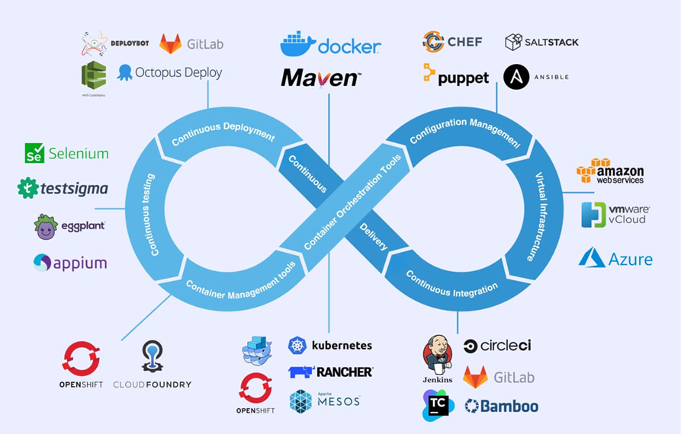
DevOps Toolchain

Slide 28
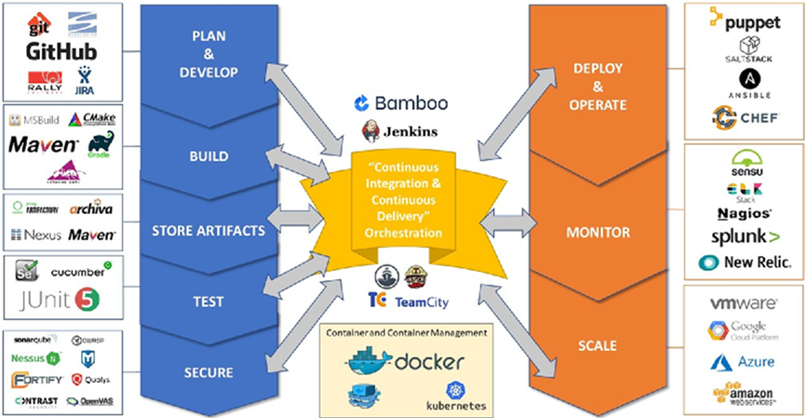
DevOps Tools

Slide 29
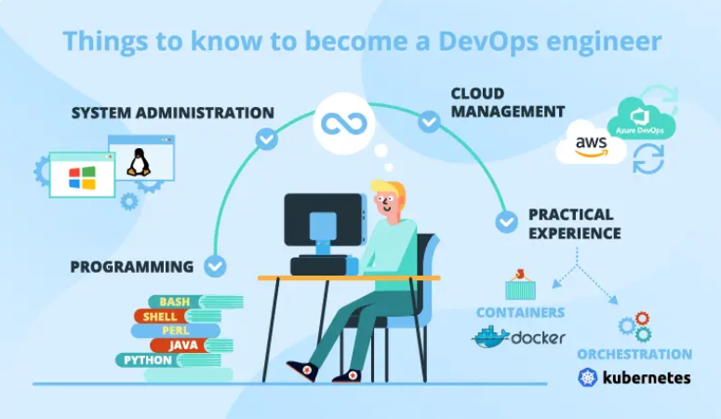
DevOps Learning – Prerequisites

Slide 30
DevOps Areas of work
DevOps engineering is the practice of managing an organization's developer operations (DevOps). DevOps engineers are IT professionals who work on:
Bridge the gap between development and IT operations teams
Unify, optimize, and automate processes
Balance the needs and goals of different teams
Design and manage the overall DevOps infrastructure, pipelines, and processes
Infrastructure as Code (IaC) is a DevOps practice that uses code to manage and provision computing infrastructure, instead of manual processes. IaC is a key component of continuous delivery and helps DevOps teams work together to deliver applications and their infrastructure quickly and reliably
Container Orchestration in DevOps is a method for organizing and handling multiple containers and microservices at scale. It automates tasks like: container scheduling, deployment, scalability, load balancing, availability, and networking.
DevOps Monitoring is the process of overseeing the development process in real-time to ensure the status of applications, services, and infrastructure is in check. It involves the following stages of the development process: planning, development, integration and testing, deployment, and operations.
DevOps Logging is the process of tracking and storing data about an application or system. This data can include information about access, application performance, changes, and the impact of those changes

Slide 31
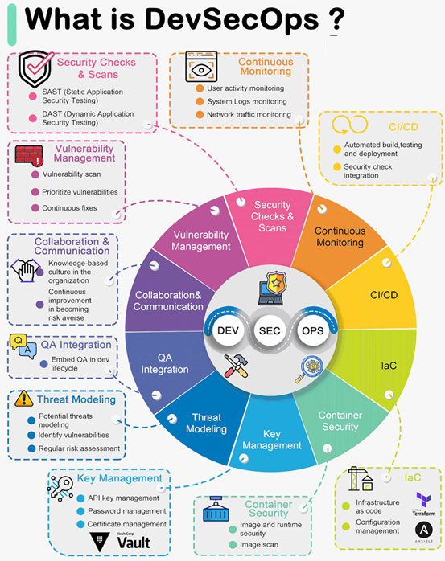
DevSecOps

Slide 32
The original 12 factors methodology : The "12 Factor App" offers a set of best practices for building modern software applications. Following these 12 principles can help developers and teams in building reliable, scalable, and manageable applications
Codebase – One codebase tracked in revision control, many deploys
Dependencies – Explicitly declare and isolate dependencies
Configuration – Store configuration in the environment
Backing services – Treat backing services as attached resources
Build, release, run – Strictly separate build and run stages
Processes – Execute the app as one or more stateless processes
Port binding – Export services via port binding
Concurrency – Scale-out via the process model
Disposability – Maximize robustness with fast start-up and graceful shutdown
Dev/prod parity – Keep development, staging, and production as similar as possible
Logs – Treat logs as event streams
Admin processes – Run admin/management tasks as one-off processes

Slide 33
12-Factor App
Codebase: Have one place to keep all your code, and manage it using version control like Git.
Dependencies: List all the things your app needs to work properly, and make sure they're easy to install.
Config: Keep important settings like database credentials separate from your code, so you can change them without rewriting code.
Backing Services: Use other services (like databases or payment processors) as separate components that your app connects to.
Build, Release, Run: Make a clear distinction between preparing your app, releasing it, and running it in production.
Processes: Design your app so that each part doesn't rely on a specific computer or memory. It's like making LEGO blocks that fit together.
Port Binding: Let your app be accessible through a network port, and make sure it doesn't store critical information on a single computer.
Concurrency: Make your app able to handle more work by adding more copies of the same thing, like hiring more workers for a busy restaurant.
Disposability: Your app should start quickly and shut down gracefully, like turning off a light switch instead of yanking out the power cord.
Dev/Prod Parity: Ensure that what you use for developing your app is very similar to what you use in production, to avoid surprises.
Logs: Keep a record of what happens in your app so you can understand and fix issues, like a diary for your software.
Admin Processes: Run special tasks separately from your app, like doing maintenance work in a workshop instead of on the factory floor.

Slide 34
